Slide 1
Intro to Probability
Week 4
Professor Gia Barboza-Salerno
College of Social Work
The Ohio State University
Week 4: Intro to Probability Theory and Sampling Distributions
September 12, 2023

Slide 2
Hypothesis Testing in a Probabilistic Framework

Slide 3
Intro to probability theory
The magazine Discover once had a special issue on “Life at Risk.” In an article, Jeffrey Kluger describes the risks of making it through one day:
Imagine my relief when I made it out of bed alive last Monday morning. It was touch and go there for a while, but I managed to scrape through. Getting up was not the only death-defying act I performed that day. There was shaving, for example; that was no walk in the park. Then there was showering, followed by leaving the house and walking to work and spending eight hours at the office. By the time I finished my day – a day that also included eating lunch, exercising, going out to dinner, and going home – I counted myself lucky to have survived in one piece.
Is this writer unusually fearful? No, why?

Slide 4
Intro to probability theory
”There is not a single thing you can do ... that isn’t risky enough to be your last.”
Examples
1 out of 2 million people will die from falling out of bed.
1 out of 400 will be injured falling out of bed
1 out of 77 adults over 35 will have a heart attack this year
Black Americans are twice as likely to be shot by the police compared to Whites (https://www.washingtonpost.com/graphics/investigations/police-shootings-database/)
The average American faces a 1 in 13 risk of suffering some kind of injury in home that
necessitates medical attention
1 out of 32 risk of being the victim of some violent crime, 1 out of 14 risk of having property stolen this year
These are all probabilities that were calculated from counts of reported accidents

Slide 5
Probability
The point is that we talk loosely about probability all the time, but we need to be more specific in terms of defining and using probabilities because as I will demonstrate with a couple of examples, the consequences are deadly

Slide 6
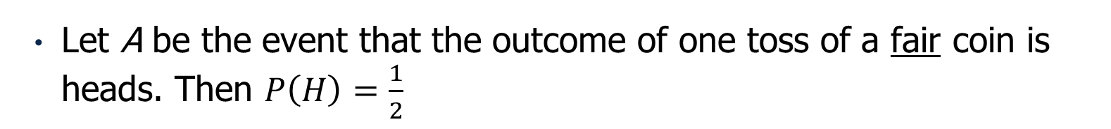
The Sample Space
A Sample Space is a list of all possible outcomes, or events, of an experiment
Example: List the possible sample space for 1 toss of a fair coin.
S = {H, T }
Example: List the possible sample space for 2 tosses of a fair coin.
Let A be the event that the outcome of one toss of a fair coin is heads. Then $P\left(H\right)=\frac{1}{2}$

Slide 7
Events & Sample Spaces
A random process is a phenomenon whose outcome cannot be predicted with certainty
A probability event, A, is a collection of outcomes of an experiment. More specifically an event is the subset of the sample space. The sample space is the entire possible set of outcomes of an experiment.
Random Process | Event
Flipping a coin | Obtaining heads
Rolling a die | Getting a “5”
Flipping a coin 10 times | Getting 3 heads in 10 tosses
Getting the covid vaccine | Getting Covid
100 children graduate high school | 4 of the 100 will go to Yale

Slide 8
Probability: An assessment of risk
There is a modest amount of theory we can cover. I will introduce some basic concepts of probability theory and then present some applications. This is meant to give you some basic skills by which to challenge what you read.
A probability is a number that lies between 0 and 1 that measures the uncertainly of a particular event
Mathematically, the probability of an outcome is simply
P(outcome) = ^{A}
S
where A = the number of ways an event can occur and S = the total number of possible outcomes
The probability of an event occurring is the fraction of time that it would happen if the random process occurs repeatedly under the same conditions
Note: A = S x P(outcome), i.e., the number of ways an event can occur = the total number of possible outcomes times the probability that the event will occur. This is also called the expectation.

Slide 9
Harder: The Sample Space
List all possible outcomes of 1 toss of a fair die
List all possible outcomes of 1 toss of two fair die and then compute the probability of observing a total score of 6? At least 6? At most 12?

Slide 10
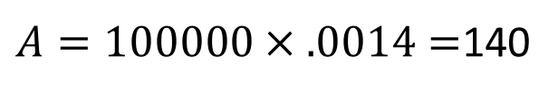
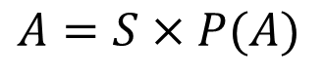
Example
The probability of being dealt a full house in poker is .0014. If you were dealt 100,000
poker hands, how many full houses should you expect?
Let A = the number of full houses we might expect, the P(A) = .0014 and S = 100,000, then:
$$A=S×P(A)$$
$A=100000×.0014=$140
Note: this is interpreted as a long-run average… Clearly, anything can happen at anytime.

Slide 11
Assigning Probabilities
Any probability that is assigned must fall between 0 and 1
The sum of the probabilities across all outcomes must be equal to 1
An outcome will be assigned a probability of 0 if one is sure that that outcome will never occur
Likewise, if one assigns a probability of 1 to an event, then that event must occur all the time.

Slide 12
Formal Rules of Probability
Numbers called probabilities are assigned to outcomes in the sample space such that the sum of the numbers over all outcomes is equal to one. Example.
Suppose that the sample space for our random experiment is S
We denote an event by a letter, say A, where A is a subset of S
We are often interested in events that are derived from other events
Rolling a 2 OR a 3
Patient who receives therapy for trauma is relieved of symptoms AND has better communication skills
Events derived from other events can be described as follows
A ∩ B is the event that both A and B occur, i.e. the intersection of two events
A ∪ B is the event that either A or B occur, i.e. the union of two events
A^{c} is the event that A does not occur (called the complement of A)

Slide 13
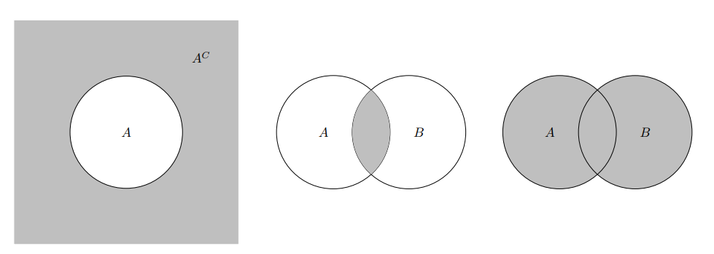
Venn Diagrams

Slide 14
Illustration
Suppose I choose a student at random from class and record the month he, she or they were born. The student could be born during any of the 12 months.
List the sample space of the experiment
Let A = the student was born during the last half of the year and B = the student is born during a month that is four letters long.
Describe the following events in words and find each
A ∩ B
A ∪ B
A^{c} and B^{c}

Slide 15
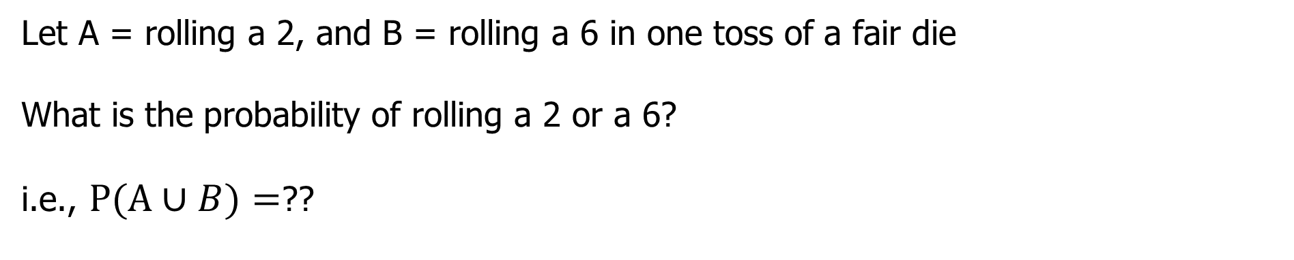
Union of Events
Let A = rolling a 2, and B = rolling a 6 in one toss of a fair die
What is the probability of rolling a 2 or a 6?
i.e., $P(A∪B)=$??
It seems that P(A∪𝐵)= P(A) + P(B) however this is generally not true

Slide 16
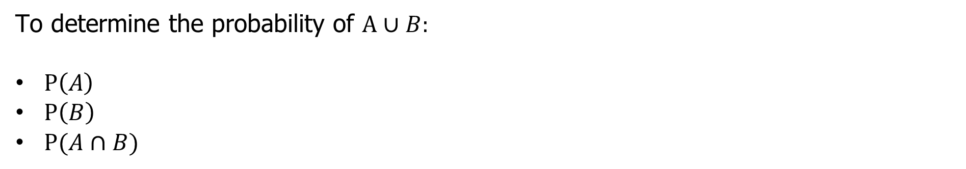
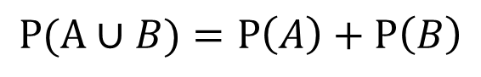
The Addition Rule
To determine the probability of $A∪B:$
$P\left(A\right)$
$P\left(B\right)$
$P(A∩B)$
$$P(A∪B)=P\left(A\right)+P\left(B\right)−P(A∩B)$$
In the previous example, why does
$$P(A∪B)=P\left(A\right)+P\left(B\right)$$

Slide 17
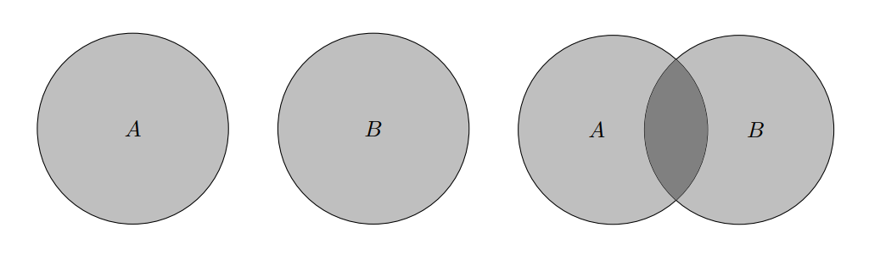
Example
Let A = the event of rolling a 1,2, or 3 and B = the event of getting an odd number. What is the probability of A OR B?
List the sample space…

Slide 18
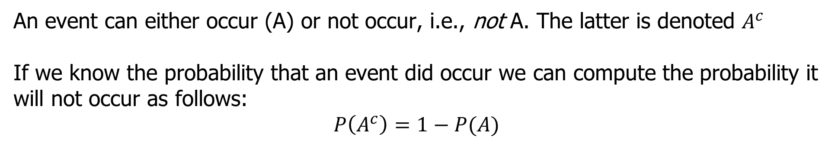
The Complement
An event can either occur (A) or not occur, i.e., not A. The latter is denoted $A^{c}$
If we know the probability that an event did occur we can compute the probability it will not occur as follows:
$$P\left(A^{c}\right)=1−P(A)$$

Slide 19
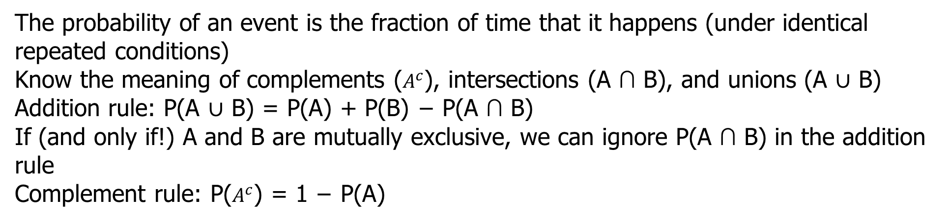
Summary
The probability of an event is the fraction of time that it happens (under identical repeated conditions)
Know the meaning of complements ($A^{c}$), intersections (A ∩ B), and unions (A ∪ B)
Addition rule: P(A ∪ B) = P(A) + P(B) − P(A ∩ B)
If (and only if!) A and B are mutually exclusive, we can ignore P(A ∩ B) in the addition rule
Complement rule: P($A^{c}$) = 1 − P(A)

Slide 20
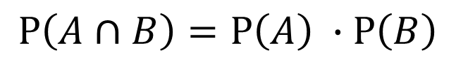
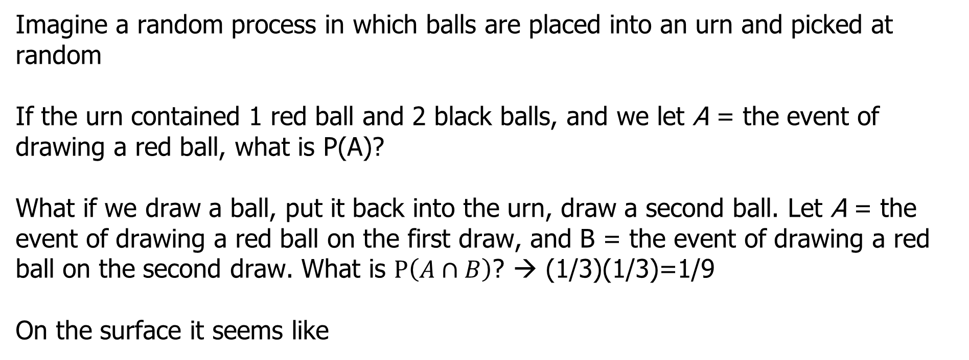
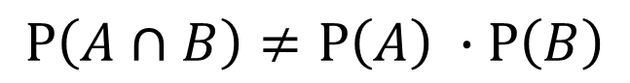
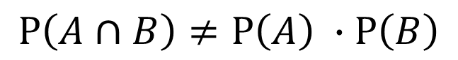
Independence: Balls in Urns
Imagine a random process in which balls are placed into an urn and picked at random
If the urn contained 1 red ball and 2 black balls, and we let A = the event of drawing a red ball, what is P(A)?
What if we draw a ball, put it back into the urn, draw a second ball. Let A = the event of drawing a red ball on the first draw, and B = the event of drawing a red ball on the second draw. What is $P\left(A∩B\right)$? → (1/3)(1/3)=1/9
On the surface it seems like
$$P\left(A∩B\right)=P\left(A\right) ∙P\left(B\right)$$
BUT
$$P\left(A∩B\right)≠P\left(A\right) ∙P\left(B\right)$$
Note carefully, if
$$P\left(A∩B\right)≠P\left(A\right) ∙P\left(B\right)$$
then A and B are NOT independent

Slide 21
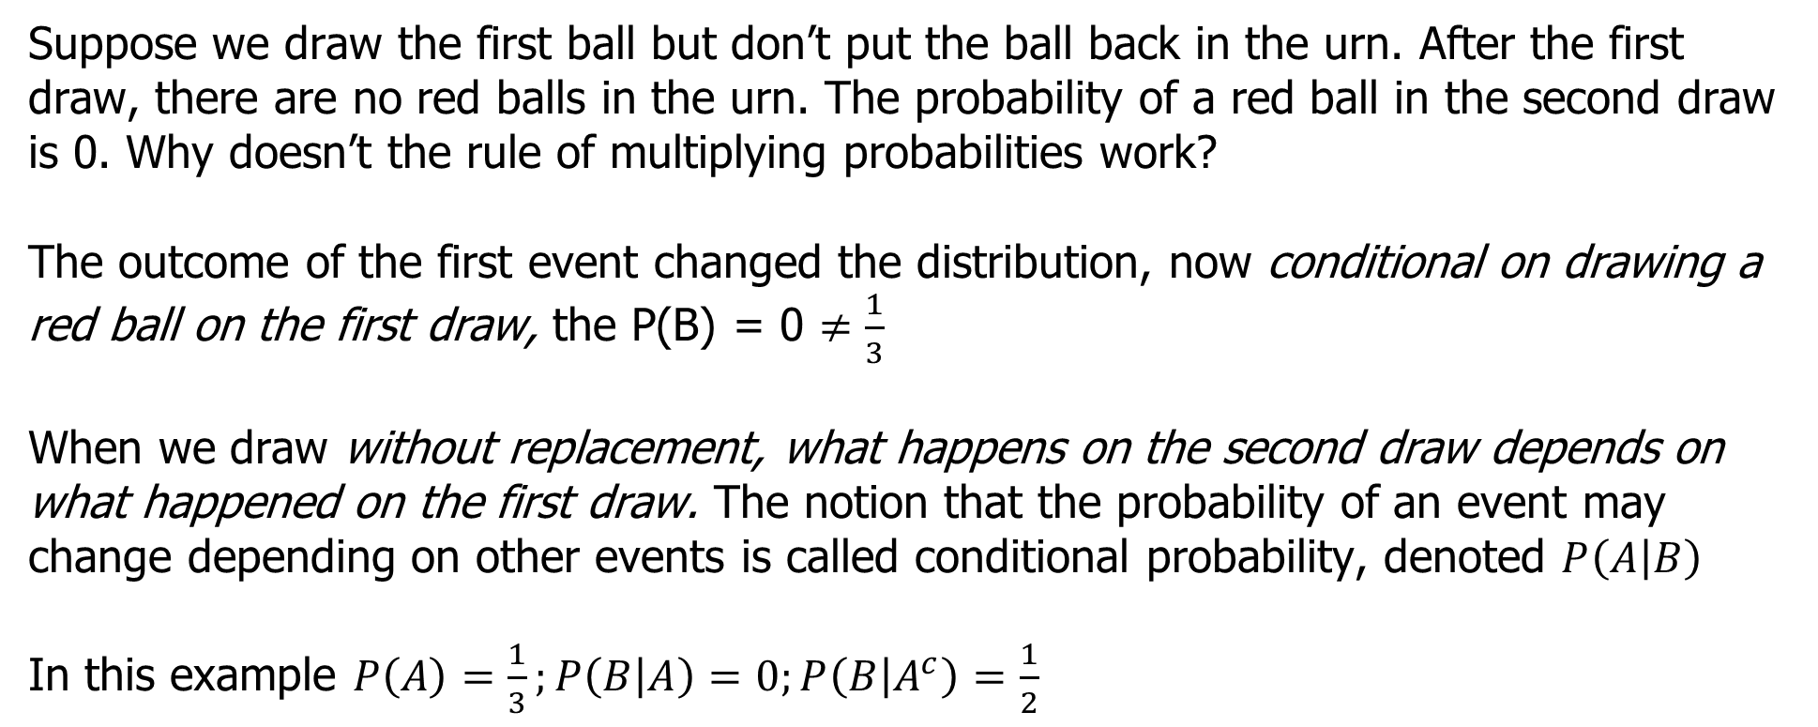
Balls in Urns
Suppose we draw the first ball but don’t put the ball back in the urn. After the first draw, there are no red balls in the urn. The probability of a red ball in the second draw is 0. Why doesn’t the rule of multiplying probabilities work?
The outcome of the first event changed the distribution, now conditional on drawing a red ball on the first draw, the P(B) = 0 $≠\frac{1}{3}$
When we draw without replacement, what happens on the second draw depends on what happened on the first draw. The notion that the probability of an event may change depending on other events is called conditional probability, denoted $P\left(A | B\right)$
In this example $P\left(A\right)=\frac{1}{3};P\left(B | A\right)=0;P\left(B | A^{c}\right)=\frac{1}{2}$

Slide 22

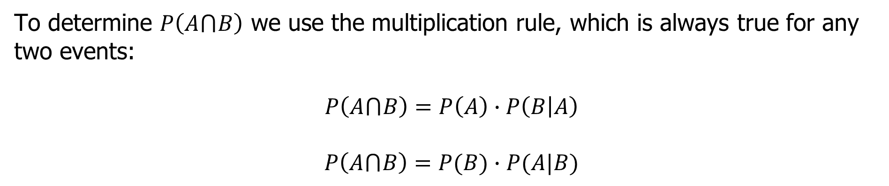

The multiplication rule
To determine $P\left(A⋂B\right)$ we use the multiplication rule, which is always true for any two events:
$$P\left(A⋂B\right)=P\left(A\right)∙P\left(B | A\right)$$
$$P\left(A⋂B\right)=P(B)∙P(A|B)$$
The multiplication rule allows us to compute conditional probabilities as well, by re-arranging the formula
$$P\left(B | A\right)=\frac{P\left(A⋂B\right)}{P\left(A\right)}$$
Note: this is the idea behind dependence
$$P\left(A | B\right)=\frac{P\left(A⋂B\right)}{P\left(B\right)}$$

Slide 23
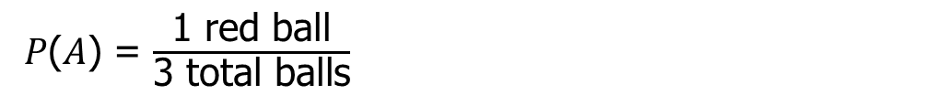
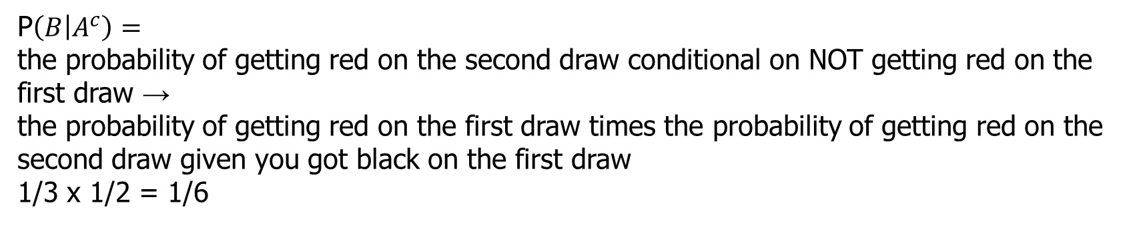
Here it is
1 red balls, 2 black balls
A = the event of drawing a red ball on the first toss,
B = the event of drawing a red ball on the second toss
𝑃(𝐴) = $\frac{\text{1 }\text{red} \text{ball}}{\text{3} \text{total} \text{balls}}$
$P\left(B | A\right)$ = the probability of getting a red ball on the second draw conditional on getting a red ball on the first draw which is clearly 0. There are no red balls left
P$\left(B | A^{c}\right)=$
the probability of getting red on the second draw conditional on NOT getting red on the first draw →
the probability of getting red on the first draw times the probability of getting red on the second draw given you got black on the first draw
1/3 x 1/2 = 1/6

Slide 24
Independence
As we have seen before, there are times when one event is completely unaffected by another event
If one event, B, is not affected by another event, A, then the probability of B given A is equal to the probability of B, i.e.,
P(B|A) = P(B)
Then we say that A and B are independent. If the probability of A depends on B (or vice versa) then A and B are dependent

Slide 25
Dependence and Independence
For each, state P(B|A)
Event A | Event B
Patient recovers | Patient got treatment
Student is admitted to Yale | Students father went to Yale
Person is arrested while bird watching | Bird watcher is Black

Slide 26
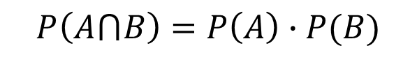
Independence and the Multiplication Rule
$$P\left(A⋂B\right)=P\left(A\right)∙P(B)$$
If two events, A and B, are independent then
Example: What is the probability of two heads in two tosses of a fair coin?
If two events, A and B, are dependent we need to use the multiplicative rule
Example: An urn contains 5 balls, 3 red and 2 black, and we sample without replacement two balls. What is the probability of drawing two black balls?

Slide 27

Review
If two events, A and B, are independent then
$$P\left(A⋂B\right)=P\left(A\right)∙P(B)$$
If two events, A and B, are NOT independent then
$$P\left(A⋂B\right)=P\left(A\right)∙P\left(B | A\right)$$
$$P\left(A⋂B\right)=P(B)∙P(A|B)$$

Slide 28
Example
An article in the American Journal of Public Health reported that in a certain population, the probability that a child’s gestational age is less than 37 weeks is 0.142
The probability that his or her birth weight is less than 2500 grams is 0.051
The probability of both is 0.031
Let A = P(gestational age < 37 weeks) and
Let B = P(bw < 2500 g)
Are A and B independent?
For a randomly selected child, what is the probability that A or B will occur?

Slide 29
Example
Assume the probability that a child’s gestational age is less than 37 weeks is .142, the probability that the child’s birth weight is less than 2500 grams is .051, and the probability of both is .031.
What is the probability that a child’s birth weight will be less than 2500 g given that the child’s gestational age is less than 37 weeks?

Slide 30
The Case of Sally Clark
Clark's first son died in December 1996 within a few weeks of his birth.
Her second son died in similar circumstances in January 1998.
A month later, Clark was arrested and tried for both deaths.
Both sides agreed that neither baby died of SIDS
Sir Roy Meadow, a pediatrician testified as to the probability of observing two deaths by SIDS in the same household

Slide 31
A gross miscarriage of justice….
“… it’s the chance of backing that long odds outsider at the Grand National, you know; let’s say it’s a 80 to 1 chance, you back the winner last year, then the next year there’s another horse at 80 to 1 and it is still 80 to 1 and you back it again and it wins. Now here we’re in a situation that, you know, to get to these odds of 73 million you’ve got to back that 1 in 80 chance four years running, so yes, you might be very, very lucky because each time it’s just been a 1 in 80 chance and you know, you’ve happened to have won it, but the chance of it happening four years running we all know is extraordinarily unlikely. So it’s the same with these deaths. You have to say two unlikely events have happened and together it’s very, very, very unlikely.”
Comment on the expert’s testimony.

Slide 32
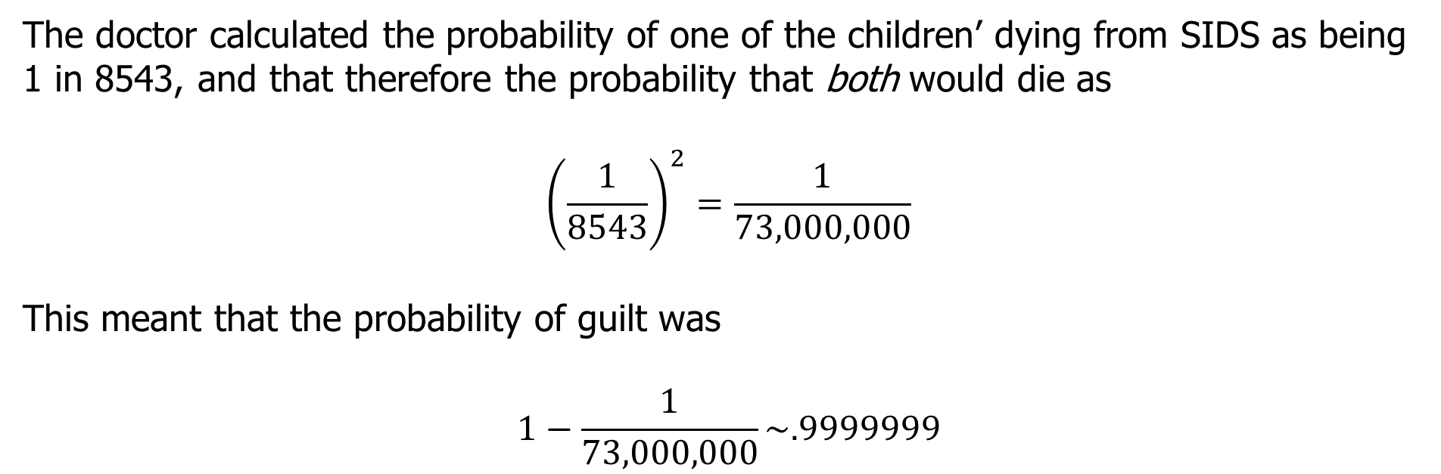
The Mistake
The doctor calculated the probability of one of the children’ dying from SIDS as being 1 in 8543, and that therefore the probability that both would die as
$${\left(\frac{1}{8543}\right)}^{2}=\frac{1}{73,000,000}$$
This meant that the probability of guilt was
$$1−\frac{1}{73,000,000}\sim .9999999$$

Slide 33
The Response
The calculation leading to 1 in 73 million is invalid. It would only be valid if SIDS cases arose independently within families, an assumption that would need to be justified empirically. Not only was no such empirical justification provided in the case, but there are very strong reasons for supposing that the assumption is false. There may well be unknown genetic or environmental factors that predispose families to SIDS, so that a second case within the family becomes much more likely than would be a case in another, apparently similar, family.
Also, IF a child is murdered the likelihood that a parent did it is quite high. However, the likelihood of a child being killed by a parent is thankfully very small…

Slide 34
“A Spectacular Miscarriage of Justice”: The Sudden Infant Death Study at Trial
 | SIDS incidence in this group*
Rate for groups with different factors
Anybody smokes in the household (SIDS more likely) Nobody smokes in the household | in 737 in 5041
No waged income in the household At least one waged income in the household | in 486 in 2088
Mother <27 years and parity Mother > 26 years and parity | in 567 in 1882
None of these factors One of these factors Two of these factors All three of these factors | in 8543 in 1616 in 596 in 214
Notes:
the CESDI study showed that the risk of a child dying of SIDS in a household where none of the three risk factors listed above was present was 1 in 8,543 live births

Slide 35
People v. Collins (1968) – another miscarriage of justice
Juanita Brooks was robbed in an alley and her purse was stolen. A witness testified at trial that she saw a blonde woman run out of the alley and enter a partly yellow car driven by a Black male with a mustache and beard. After testimony from a local math professor about the multiplication rule in probability (i.e., the independence rule), the jury was told to consider the probability that the suspects, who fit the description of the witnesses, were not the culprits. The following probabilities were offered to the jury:

Slide 36
The Evidence
Yellow car 1/10
Man with moustache 1/4
Girl with ponytail 1/10
Girl with blond hair 1/3
Black man with beard 1/10
Interracial couple in car 1/1000
The probability of guilt is about 1 because the probability of these things occurring is 1/12,000,000…
Prosecution: There was a 1 in 12 million chance that a couple other than these defendants committed this crime.
Notes:
So their guilt is obvious! The jury convicted.
The question remains: Is their guilt obvious?

Slide 37
Challenges…
Evidentiary Foundations?
Independent Events?
Reporting Bias? – is this what was really observed?
The 1 in 12 million figure does not relate to the probability of guilt

Slide 38
So far, we have discussed the probability of single events
In research, however, the data we collect consists of many events (for each subject, does he/she contract polio?)
We then summarize those events with a number (out of the 200,000 people who got the vaccine, how many contracted polio?)
Such a number is an example of a random variable

Slide 39
Distributions
In our sample, we observe a certain value of a random variable
In order to assess the variability of that value, we need to know the chances that our random variable could have taken on different values depending on the true values of the population parameters
This is called a distribution
A distribution describes the probability that a random variable will take on a specific value or fall within a specific range of values
Random Variable | Possible Outcomes
# of women who will be sexually assaulted | 0,1,2,…
# of veterans diagnosed with PTSD | 0,1,2,…
# of ACEs | 0,1,2,…

Slide 40
Back to the Coin Toss
Suppose we flip a coin three times. What is the probability that exactly one of the flips will be heads?
Possible outcomes
S = {HHH, HHT, HTH, HTT, THH, THT, TTH, TTT}
P(HHH) = 3/8
How did I count the number of ways that I could get three heads? If there are a large number of “things” this quickly becomes infeasible…

Slide 41
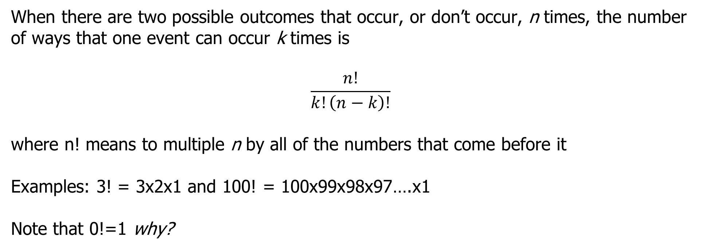
Binomial Coefficients
When there are two possible outcomes that occur, or don’t occur, n times, the number of ways that one event can occur k times is
$$\frac{n!}{k!\left(n−k\right)!}$$
where n! means to multiple n by all of the numbers that come before it
Examples: 3! = 3x2x1 and 100! = 100x99x98x97….x1
Note that 0!=1 why?

Slide 42
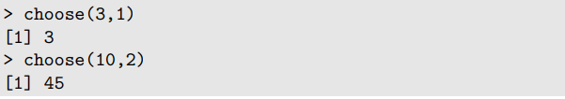
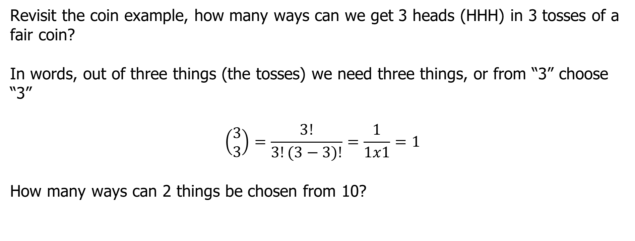
Revisit the coin example, how many ways can we get 3 heads (HHH) in 3 tosses of a fair coin?
In words, out of three things (the tosses) we need three things, or from “3” choose “3”
$$\left(\begin{aligned}3 \\ 3\end{aligned}\right)=\frac{3!}{3!(3−3)!}=\frac{1}{1x1}=1$$
How many ways can 2 things be chosen from 10?

Slide 43
Example
Suppose one has a bowl with 4 black balls and 2 white balls. Draw two balls at random. What are the possibilities? What is the probability of getting 2 white balls?
Suppose now the bowl has 100 balls, 25 balls are black and 75 balls are white. Select 12 balls at random. What is the probability that you get 12 white balls?
How many black balls would you expect to see in your sample of N = 12?

Slide 44
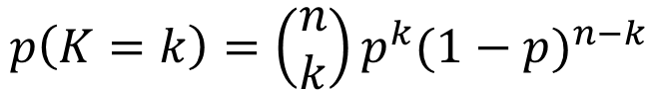
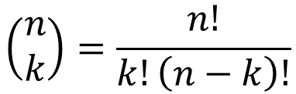
The Binomial Sampling Distribution
To calculate the probability of observing X results in n trials use the Binomial formula
The binomial coefficient is defined by the next expression:
$$\left(\begin{aligned}n \\ k\end{aligned}\right)=\frac{n!}{k!\left(n−k\right)!}$$
The binomial formula is defined by :
$$p\left(K=k\right)=\left(\begin{aligned}n \\ k\end{aligned}\right)p^{k}{(1−p)}^{n−k}$$
where X = the number of successes, n = the number of trials, p = the probability of success on each trial

Slide 45
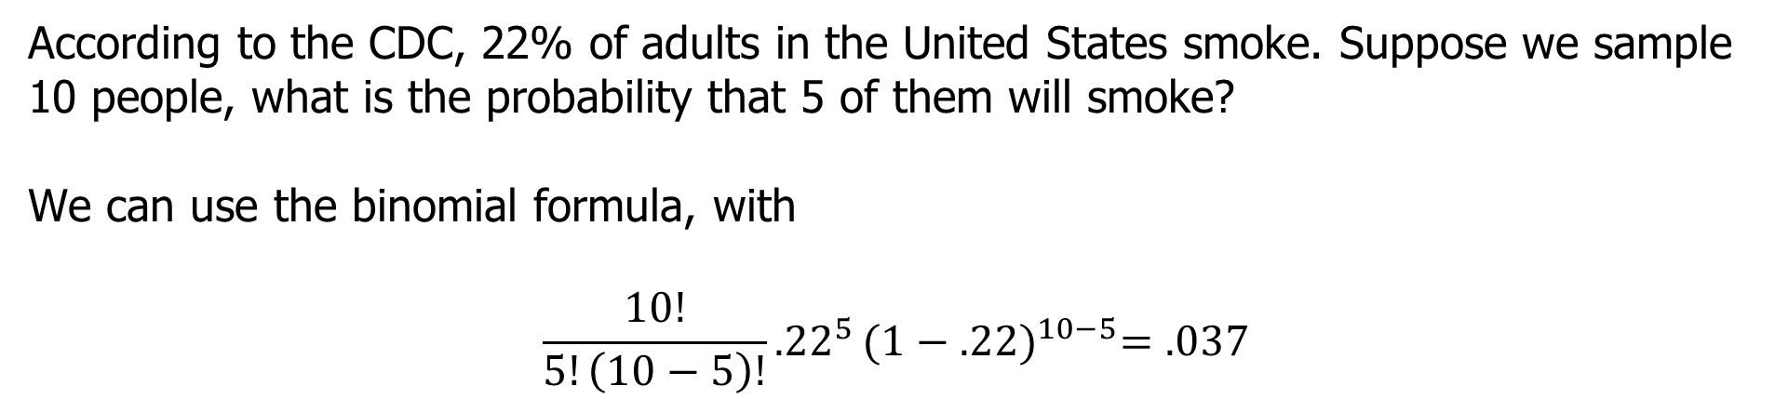
According to the CDC, 22% of adults in the United States smoke. Suppose we sample 10 people, what is the probability that 5 of them will smoke?
We can use the binomial formula, with
$$\frac{10!}{5!\left(10−5\right)!}{.22}^{5}{(1−.22)}^{10−5}=.037$$
What is the probability that our sample will contain two or fewer smokers?

Slide 46
The Binomial Formula
This formula works for any random variable that counts the number of times an event occurs out of n trials, provided that the following assumptions are met:
The number of trials n must be fixed in advance
The probability that the event occurs, p, must be the same from trial to trial
The trials must be independent
If these assumptions are met, the random variable is said to follow a binomial distribution, or to be binomially distributed

Slide 47
Real Juror Data: The Fifth circuit is ~40% black
How many black jurors would you expect if the trial is fair?
Ratio of Black Jurors to White Jurors | Number of trials (literally)
0:12 | 14
1:11 | 19
2:10 | 27
3:9 | 28
4:8 | 27
5:7 | 24
6:6 | 22
7:5 | 13
8:4 | 4
9:3 | 2
10:2 | 1
11:1 | 0
12:0 | 0
Total | 181
Question: How to test whether jury selection is a random process (i.e., the null hypothesis)

Slide 48
How many black jurors would you expect in any trial?
If the composition of the jury pool is 40% black how many black people would you expect to be on the jury?
We would expect .4*12 = ~4.8 blacks on the jury, or 5…
Does this cast doubt on whether the sampling was truly random?
What assumptions?
Notes:
If the composition of the jury pool is 40% black, we would expect .4*12 = ~4.8 blacks on the jury, or 5…

Slide 49
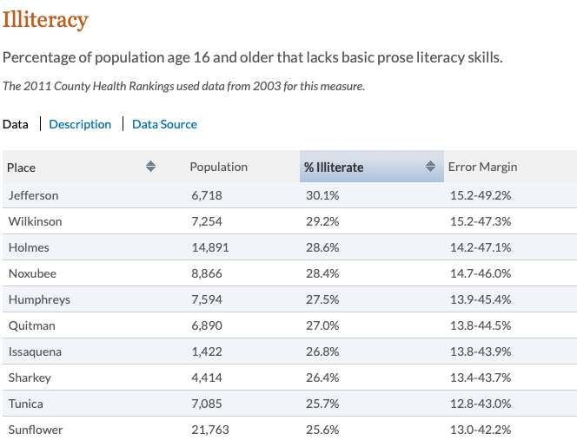
2 MS Code § 13-5-1 (2017)
https://github.com/APM-Reports/jury-data
To be eligible for jury-duty in Mississippi, a person must live in the county the trial is conducted in, be able to read and write, must not have been convicted of an ‘infamous crime’ or the unlawful sale of alcohol, and must not be a ‘common gambler or habitual drunkard.’
An interesting question is how many people does this exclude?

Slide 50
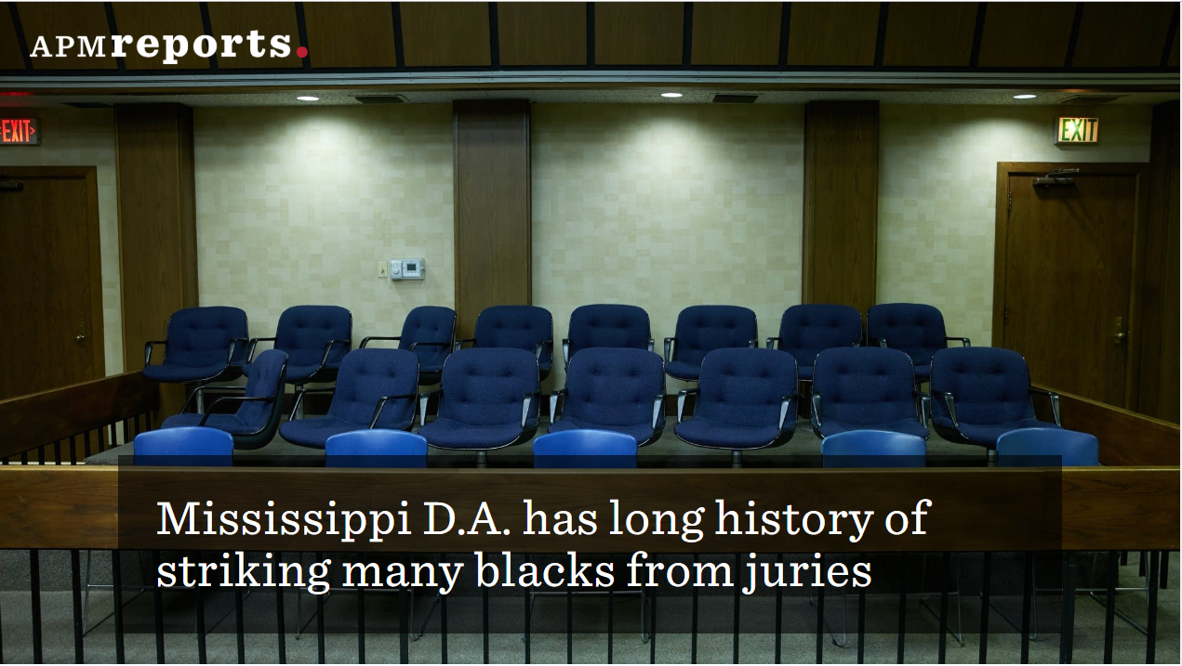
A jury of someone else’s peers
This leads to jury compositions that are grossly disproportionate in comparison to the general population

Slide 52
Oddity in Picking Jurors Opens Door to Racial Bias
Allen Snyder, a black man, is on death row in Louisiana. An all-white jury in Jefferson Parish, in the New Orleans suburbs, sentenced him to death in 1996 for the fatal stabbing of a man his wife was seeing.
(How) is it possible to get an all-white jury in Parish? In the 20 years following the lifting of the moratorium on the death penaltiy, there were 20 murder trials in Jefferson Parish that ended in death sentences. Information about the race of the jurors is available in 18 of them. Parish is 23% black, so how many jurors might we expect on each 12-member panel? of the 18 juries, 10 had no black members. Seven had one. One had two. None had three.
Notes:
I went to the census bureaus website and replicated the article's claim that 23% of the Parish's population is black.

Slide 53
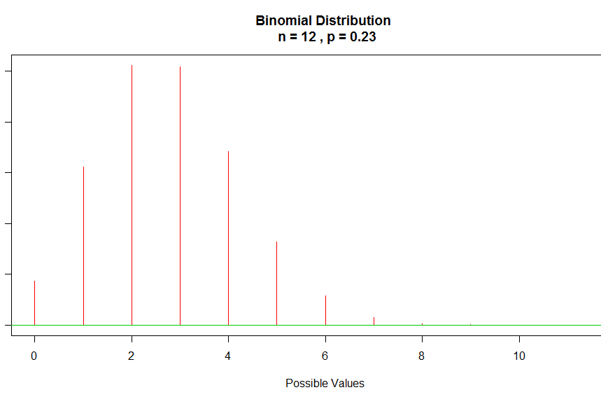
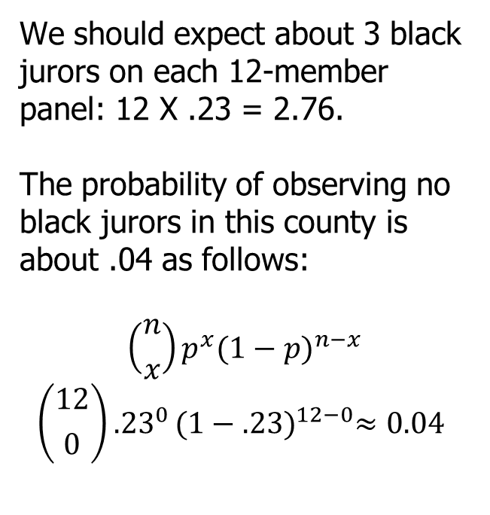
Statistical Oddity & Death
We should expect about 3 black jurors on each 12-member panel: 12 X .23 = 2.76.
The probability of observing no black jurors in this county is about .04 as follows:
$$\left({n \atop x}\right)p^{x}{(1−p)}^{n−x}$$
$$\left({12 \atop 0}\right){.23}^{0}{(1−.23)}^{12−0}≈0.04$$
Notes:
Here is graph of the probability that X black jurors would be selected for X = 0 - 12. Notice that 3 is the highest point on the graph. Another thing to notice is that it is possible to observe 0 black jurors but the probability is very small.

Slide 54
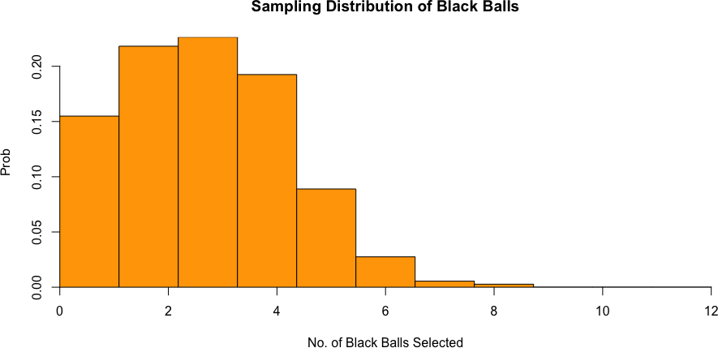
Results of Experiment
Run the balls experiment in the sampling_distributions.Rmd
No matter how many times you run this, you will never see a high probability of getting 12 black balls. Think about the
implications for this… JURY SELECTION IS NOT RANDOM…

Slide 55
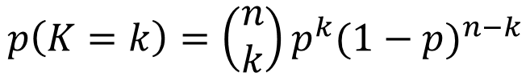
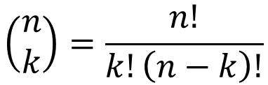
Summary
A random variable is a number that can equal different values depending on the outcome of a random process
The distribution of a random variable describes the probability that the random variable will take on those different values
The number of ways to choose k things out of n possibilities is:
Binomial distribution: the probability that an event will occur k times out of n is:
where p is the probability that the event will occur on any particular trial
$$\left(\begin{aligned}n \\ k\end{aligned}\right)=\frac{n!}{k!\left(n−k\right)!}$$
$$p\left(K=k\right)=\left(\begin{aligned}n \\ k\end{aligned}\right)p^{k}{(1−p)}^{n−k}$$

Slide 56
Examples
Calculate the probability of each of the following:
Two tails in two tosses of a fair coin.
Two heads in three tosses of a fair coin
Four heads in four tosses of an unfair coin where the probability of a head is 0.75
One six in three rolls of a fair die
Five fours in five rolls of an unfair die where the probability of a four is 0.25.

Slide 57
The Fair Coin
Example: In football, a coin toss⇒ at what point do you become suspicious that the coin is unfair?
Statistical inference provides a systematic way of determining risk
The coin toss can be thought of as a test statistic
What is H₀
What is H₁
What is the Type I error of the test statistic?
What is the Type II error?
What percentage of the time are you willing to be wrong?

Slide 58
The Fair Coin
How can we calculate the risk of a Type I error associated with a specific outcome in a test of statistical significance also called the observed significance level?
One way is to determine how often a fair coin would be that the Patriots do not always get the ball
Ultimately you are interested in determining the likelihood of getting X heads in a very large number of samples or trials of a fair coin (i.e., tosses in 16 football games for 10 years)
The resulting distribution is the sampling distribution
The shape of the distribution of the number of heads in many trials is called a binomial distribution
Let’s consider what thousands of samples of X = 10 tosses of a fair coin looks like...

